Slide 1
Automatic program repair
2020-12-10
JuHyoung Kim
kjhkjh75@naver.com

Slide 2
- Idea
The overfitting problem in automatic program repair
-> Current progress in mitigating the overfitting problem
1) Program repair tools that can prioritize the correct patch before the overfitting one
2) Validate patches generated by any program repair tool.
Second approach : Identifying Patch Correctness in Test-Based Program Repair

Slide 3
Identifying Patch Correctness in Test-Based Program Repair
Yingfei Xiong, Xinyuan Liu, Muhan Zeng, Lu Zhang, Gang Huang
ICSE2018

Slide 4
- Introduction
PATCH-SIM
- Passing test usually behaves similarly as before, while a failing test usually behaves differently
TEST-SIM
- Two tests have similar execution, they are likely to have the same test results
Steps
1) Generate a set of new test inputs.
2) Classify the newly generated test inputs as passing or failing tests by comparing them with existing test inputs.
3) Determine the correctness of the patch by comparing the executions before and after the patch for each test, including both tests.

Slide 5
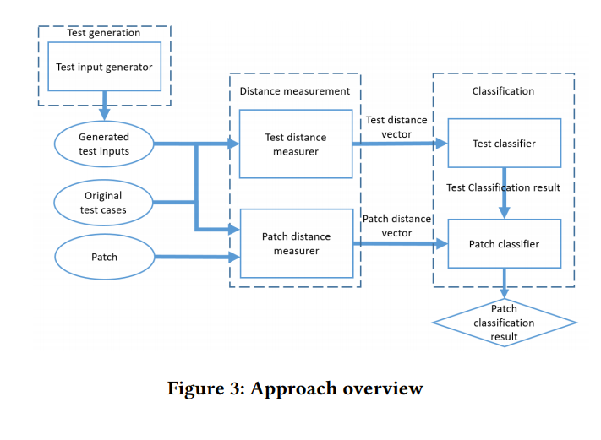
- Approach
Five components
Test generation
Test distance measurer
Patch distance measurer
Test classifier
Patch classifier

Slide 6
Approach
2. Test Generation
Generated tests to cover the patched method.
Any test input generation techniques can be used
Utilize symbolic execution techniques to cover the specific method
Adopt random testing techniques, filter out don`t cover modified method

Slide 7
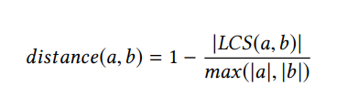
Approach
3. Distance Measurement
Measuring Distance
- complete-path spectra
Test Distance Measure
- Calculate generated test with each original test
- Executed statements with the calling context of the patched methods.
1) Entering a patched method from a method call
2) Leaving the method from the same call and keep only the statements between the positions.

Slide 8
- Approach
3. Distance Measurement
Patch Distance Measurer
- generated or original and calculates the distance between its executions on the original program and on the patched programs.
- Different from test measurer, consider the full sequence of executed statements.
- Because Same test, unlikely to be noises outside the patched method

Slide 9
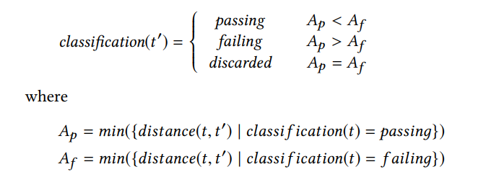

- Approach
4. Classification
Test classifier
- classifies the test result of a generated test as passing or failing.
- Difficult to precisely classify, discard these tests.
T = original test
T’ = generated test
In case of least a passing test
- No passing test case

Slide 10
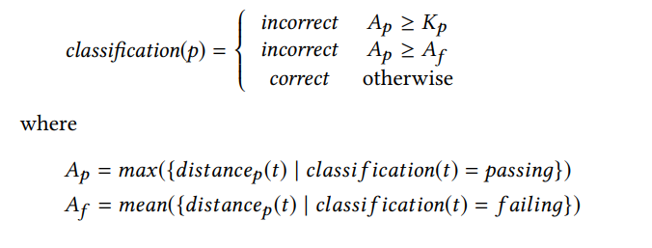
- Approach
Patch classifier
- : distance between the executions of test t before and after the patch p

Slide 11
- Evaluation
Experiment Setup
Test Generation
- Randoop to run 3minutes on the original program and collected the test sets that covered the patched methods.
- Most defects enough for 3minutes, lengthening the time would not lead to more test
- randomly selected 20 test, or selected all ( <20)
- 7.1 tests per patch in average, minimum 0
- Based on classification of Test-SIM, 71% tests passing

Slide 12
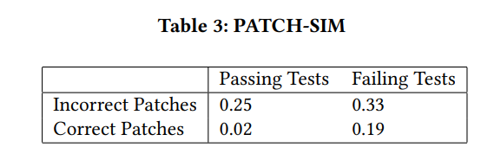
- Evaluation
Result of RQ1 : Reliability of Heuristics
Correct Patches are different Passing Test from Failing tests.
Incorrect Patches not

Slide 13
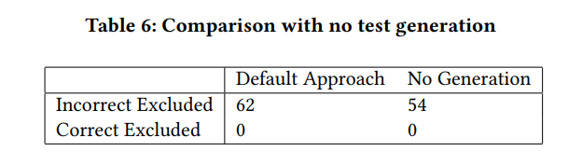
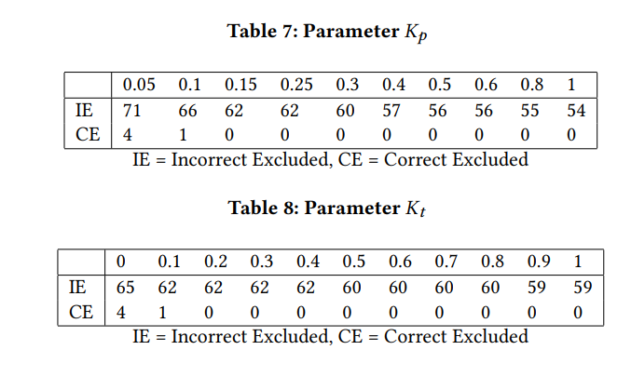
- Evaluation
Result of RQ4 : Effects of Test Generation.
Result of RQ5: Parameters
PATCH-SIM alone makes an effective.
Does not require a precise tuning of parameters.

Slide 14
- Idea
Most Apr techniques own standard for Patch generation
- ex) Pattern based, Machine learning based, Search-based…
So, their patches have risk for overfitting.
Calculating similarity before and after patch is not enough.
So We need to compare failed patch with next generated patch even though all test cases pass to find correctness.
Among plausible patches , More similarity with failed patch, should have lower rank than others.
Bug file don`t tell the techniques trend, but failed patch can tell the trend of the techniques.

